Slide 1

The International Association of Women Police
AN INTRODUCTION

Slide 2

The International Association of Women Police
A global
professional organization
for women
in policing

Slide 3
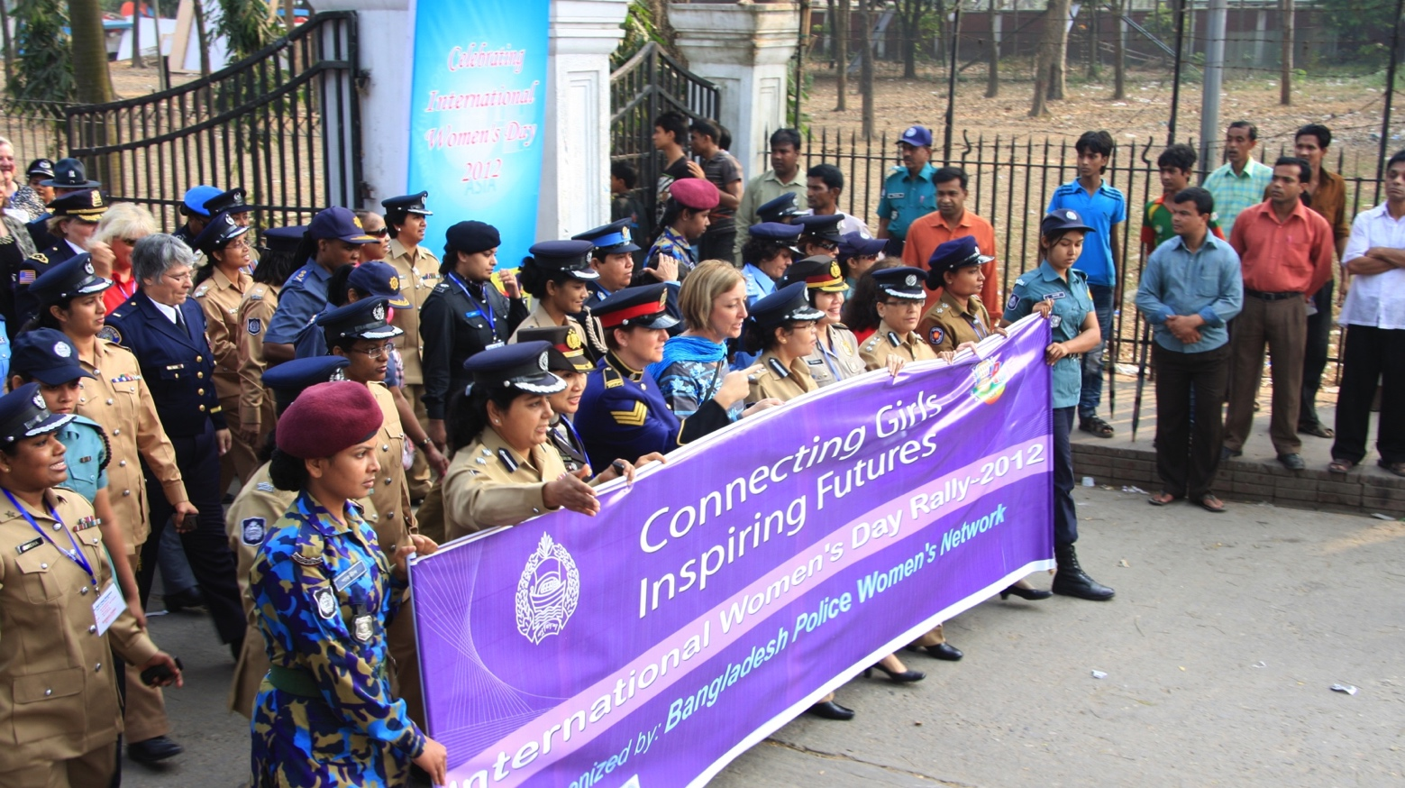
The International Association of Women Police
International Women’s Day, Dhaka, Bangladesh, 2012
Notes:
IAWP Board of Directors celebrate International Women’s Day 2012 in Dhaka, Bangladesh, at the invitation of the newly formed Bangladesh Police Women’s Network.

Slide 4
The International Association of Women Police
Our Mission
To strengthen, unite, and raise the capacity of women in policing internationally
Our Vision
A world where police reflect the diversity of the communities they serve and human rights are protected.

Slide 5
The International Association of Women Police
Our History
1915 – International Police Women’s Association
1926 – Constitution
1956 - Changed name to International Association
of Women Police (IAWP)
1963 - First IAWP Annual Training Conference
1976 – IAWP opened membership to males

Slide 6
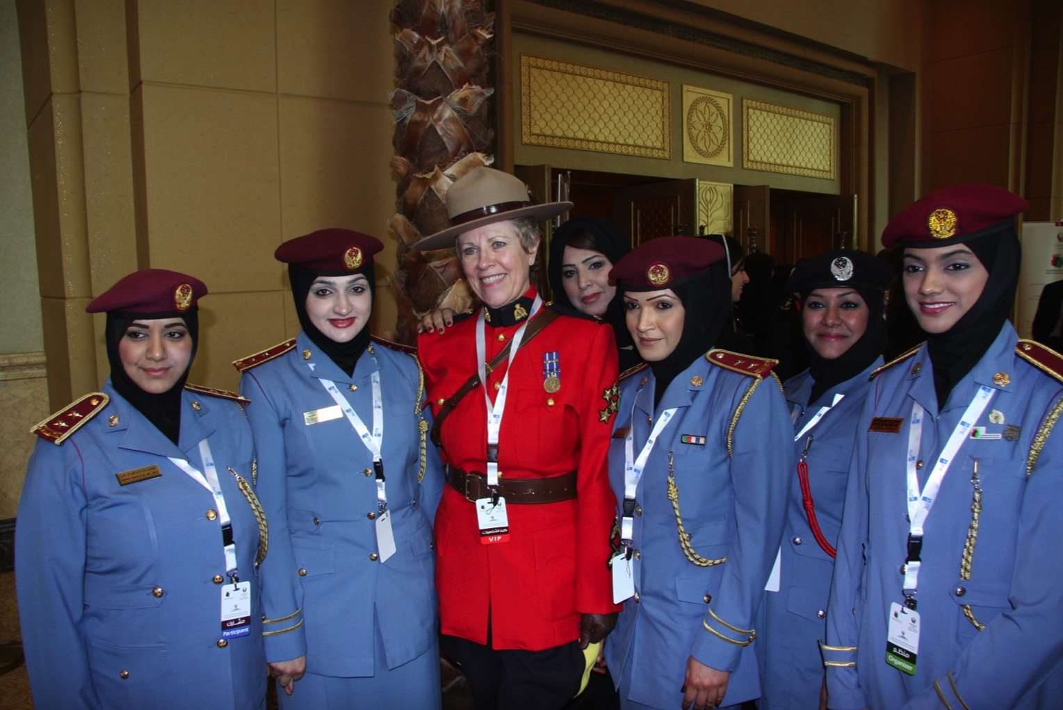
The International Association of Women Police
Immediate Past President Shorter with Emirati Police Officers
Notes:
Taken during IAWP visit by Board of Directors to the UAE in 2012 for the first Region 16 Training conference.

Slide 7
The International Association of Women Police
The IAWP Today
Members in over 60 countries
25 Affiliate organizations
4 Partnerships with sister organizations
as ‘Friends of IAWP’

Slide 8
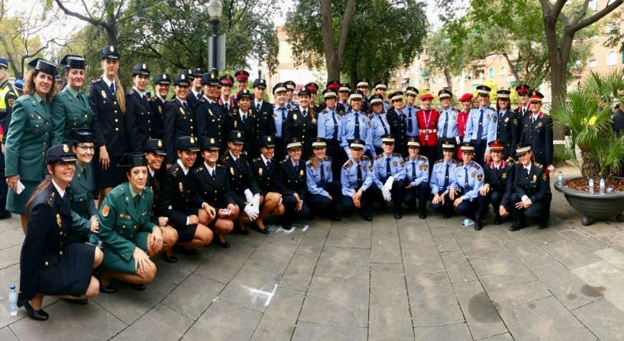
The International Association of Women Police
IAWP Regions
Notes:
Photo taken in Barcelona at Conference 2016:
In early days, 12 Regions in North America and 1 Region representing
the rest of the world.
Today, 26 Regions covering all continents except Antarctica and
truly reflecting the diversity of our global membership!

Slide 9
The International Association of Women Police
IAWP Global Regions
1 – 10 United States of America
11 – 12 Canada
13 Western Europe
14 Northern Europe (Baltic)
15 Central & Eastern Europe
16 Middle East & Gulf States
17 Northern Africa
18 Western Africa
19 Central Africa
20 Eastern Africa
21 Southern Africa
22 Central & Southern Asia
23 Eastern & South East Asia
24 Australia & Oceania
25 Central & South America
26 Caribbean

Slide 10
The International Association of Women Police
GOVERNANCE STRUCTURE
Board of Directors
President
Executive Director – presidential appointment
3 Vice Presidents
26 Regional Coordinators
Recording Secretary
Treasurer
Sergeant-at-Arms

Slide 11
The International Association of Women Police
GOVERNANCE STRUCTURE – continued
Historian
Chaplain
Board of Trustees
  All former Presidents are members of this Board
IAWP Foundation Board of Directors
  Accepts and disburses grants and donations

Slide 12
The International Association of Women Police
  FUNDING
  Membership fees
  Conference surplus
  Sponsorship
  IAWP Foundation donations
  Merchandise

Slide 13
The International Association of Women Police
  ACTIVITIES OF THE IAWP
  Training conferences: global and regional
  Adopt-an-Officer Program
  Participation in UN Commission on the Status of Women meetings New York
  Campaigns consistent with organization’s values
  Violence Against Women, Human Trafficking

Slide 14
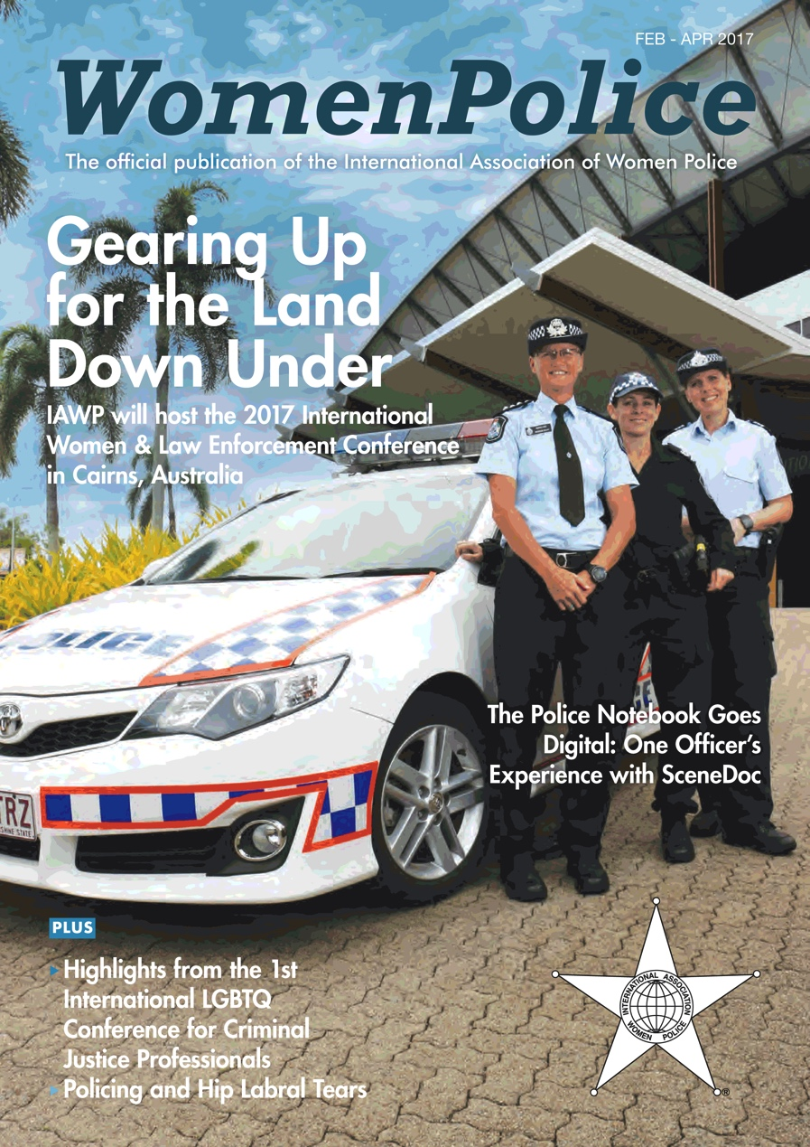
The International Association of Women Police
  COMMUNICATIONS
  Website: www.iawp.org
  WomenPolice quarterly magazine
  electronic and hard copies
  Twitter: @IAWPInfo
  Online discussion forums
  Regional news blogs
  Published research

Slide 15
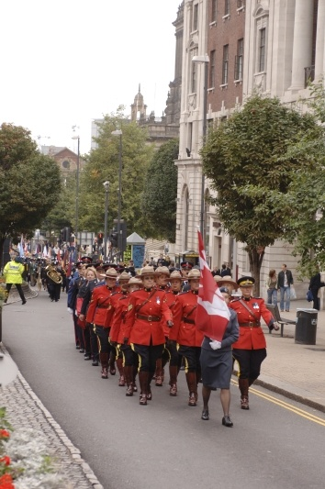
The International Association of Women Police
  IAWP TRAINING CONFERENCES
  2011 Lexington, USA
  St. John’s, Canada
  Durban, South Africa
  Winnipeg, Canada
  Cardiff, Wales, UK
  Barcelona, Spain
  Cairns, Australia
  Calgary, Canada
  2019 Anchorage, USA

Slide 16
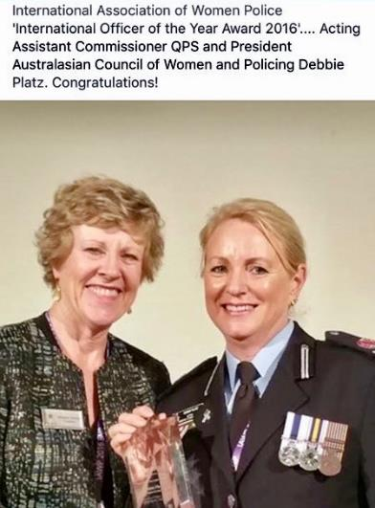
The International Association of Women Police
  IAWP ANNUAL AWARDS and RECOGNITION
  Officer of the Year
  Valour
  Excellence in Performance
  Leadership
  Mentoring
  Community Service
  Civilian Achievement
  Male Award* – in support of the UN HeforShe Campaign.
  *new in 2017

Slide 17
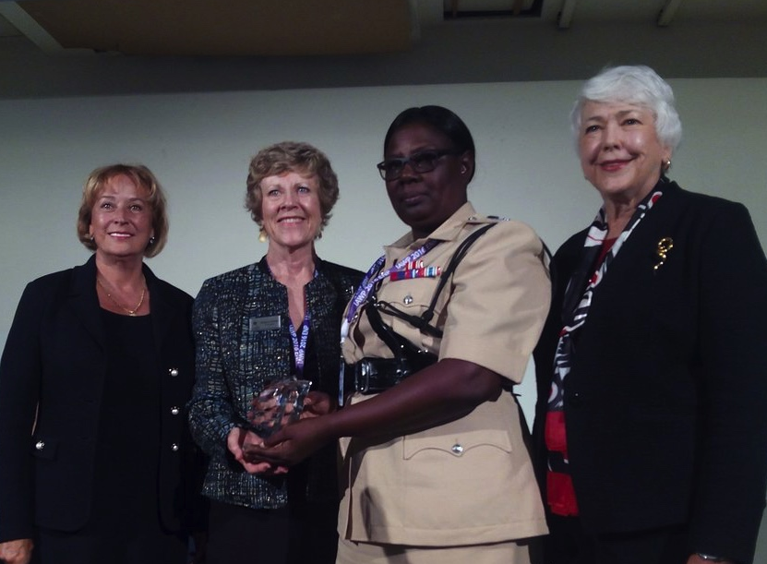
The International Association of Women Police
INTERNATIONAL SCHOLARSHIP AWARD
Notes:
International Scholarship Award winner W/Senior Superintendent Maxine L. Graham of the Guyana Police Force in Barcelona at Conference 2016.
Flanked by International Scholarship Award Committee Co-Chairs Linda Mayberry and Cindy Shain; presented by IAWP Immediate Past President Margaret Shorter.

Slide 18
The International Association of Women Police
  IAWP INTERNATIONAL SCHOLARSHIP and RECOGNITION
  CRITERIA:
  An outstanding police officer employed outside of North America
  Evidence of policing skills, the ability to increase awareness and understanding of role of women in law enforcement and ability to market the objectives of IAWP
  Recipient receives expenses to attend annual training conference

Slide 19
The International Association of Women Police
  MEMBERSHIP BENEFITS
    Global professional contacts
    Access to communities of practice for
    operational and workplace issues
    Access to police networks and expertise
    Opportunities for professional development
    Opportunities to reach out, support, work
    with women who need access to resources

Slide 20
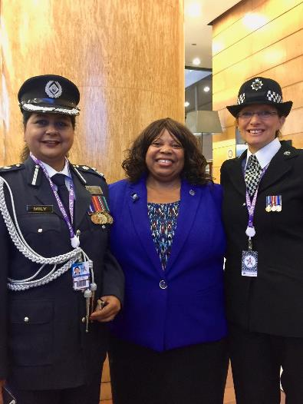
The International Association of Women Police
  MEMBERSHIP BENEFITS
  Discovery of common interests, experiences, challenges and goals
  New confidence to promote gender main-streaming in policing
  Finding that
  you are not alone!
Notes:
Board of Directors representatives Mily Biswas, Region 22 Coordinator, Past Chaplain Tamia Dow, and Region 13 Coordinator Annita Clarke in Barcelona at Conference 2016

Slide 21

The International Association of Women Police
  Why Join An Association?
  Membership can empower you and through membership you can also empower your sister officers.
Notes:
Networks are key to the exchange of information, experience, learning and support.

Slide 22
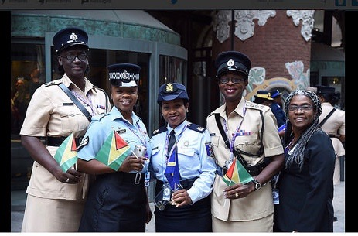
The International Association of Women Police
  …where police reflect the diversity of the communities they serve and human rights are protected - IAWP Mission
Notes:
Members of Guyana and Curaçao Police Services in Barcelona at Conference 2016

